Slide 1
Solr and Automated Testing
With a custom ESRI Web AppBuilder application
Notes:
Log in before start

Slide 2
Solr/Lucene
Document Indexing
Can be stand alone data store, but we are using it as an index on top of existing datastore. (ArcGIS Map Services)
Notes:
Super Fast, indexing engine.
Creates searchable document indexes
Solr is an open source enterprise search platform, written in Java, from the Apache Lucene project.
Can be used as a no-sql db
Lucene is the engine.
Solr is the car, how you interact to use the important engine... The doors, the gas pedal, the steering wheel etc.. most people preer not to mess with the engine.

Slide 3
Demo GSL App
www.globalseismiclibrary.com
Based on STEM app of ESRI Web AppBuilder
Notes:
3 Developers
Market place connecting buyers and sellers
Used STEM app from Web App Builder
Created custom Query/Search Pane
Some upgrades on Default Attribute Table
Detail Report
Added Authentication
Key Technologies
ESRI Web AppBuilder
Knockout
Jquery
Local Layer Widget to load

Slide 4
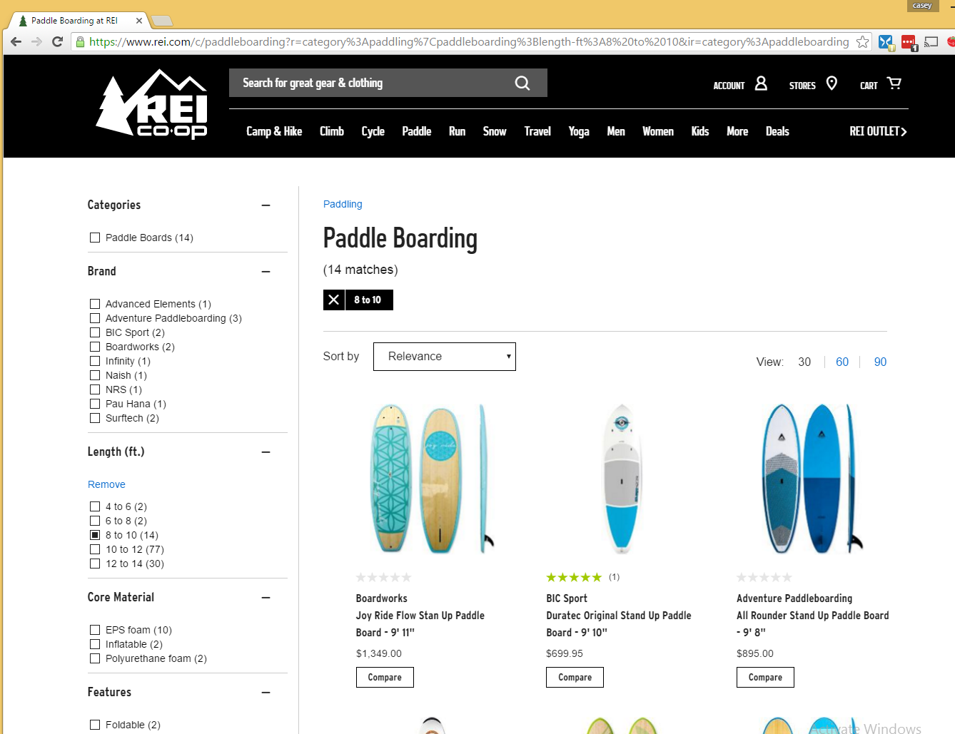
Faceting
Notes:
Faceting , sometimes called Refiniers.
Grouping of items based on a value range of a specific attribute
In this example, you can see I have refined based on the length of PaddleBoard.
So we can see counts based on groupings of an attribute, including Board Length, Brand, Price etc..

Slide 5
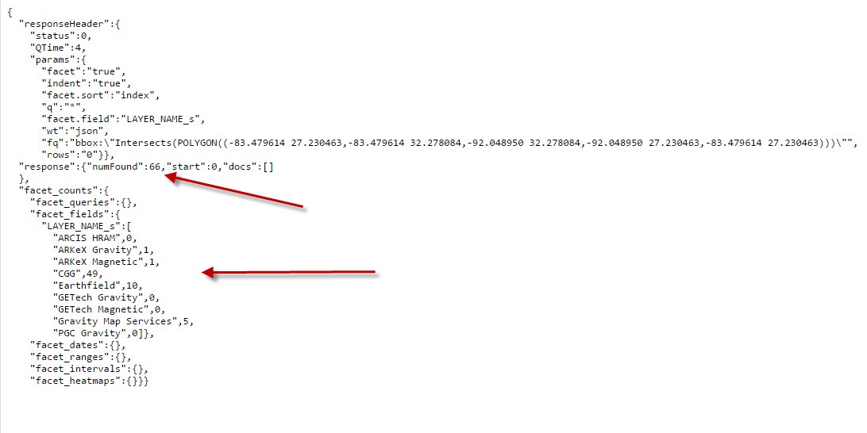
Our Facet
&facet=true &q=* &facet.field=LAYER_NAME_s &fq=bbox:"Intersects(POLYGON((-83.479614 27.230463,-83.479614 32.278084,-92.048950 32.278084,-92.048950 27.230463,-83.479614 27.230463)))"
Notes:
Keys are.. I want to facet, and I want everything from Search index as long as it is within the Bbox
We can also add to the “Q” and combine searches with text and spatial
This results come back subsecond, From those results, we can create a single query against a single layer, when a user selects.

Slide 6
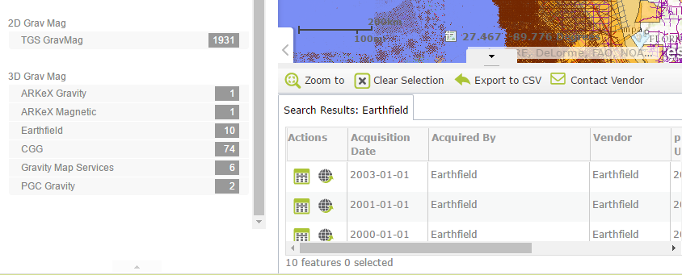
GSL Workflow
Notes:
Facets returned on left, (output using a Knockout Template)
When a user selects a row.
We use the same query against the map service single layer.
We then use create a feature class on the map, with the results, which then gets thrown to the ESRI Attribute Table widget.

Slide 7
Solr Integration
Pros :
-Speed
Cons:
-Complexity
Notes:
Harder to match queries between Solr and ESRI Rest endpoints than you'd think.
Ands and Ors, they do polygons slightly differently, they handle the polygons that cross the international date line differently
Have to keep Indexes in Sync
More Fail Points

Slide 8
Automated Testing
Level 1 :
Uptimerobot.com
Level 2 : Selenium Web Driver
Notes:
Uptime Robot : 5 minute monitoring intervals, 50 monitors
Selenium
IDE - is the firefox recorder extension
Web Driver - is the code driver, What I’m going to talk about, Used to drive any type of browser from code. Multiple languages I chose C#.
It might need an actual browser driver depending on your configuration. Can be integrated into BrowserStack and SauceLabs. Even though we have an account with BrowserStack I chose to build it outside of that as I wanted it to not be tied to our paid account.
Not designed to be Unit Testing Framework, like Jasmine or Intern, but Functional Testing of websites.

Slide 9
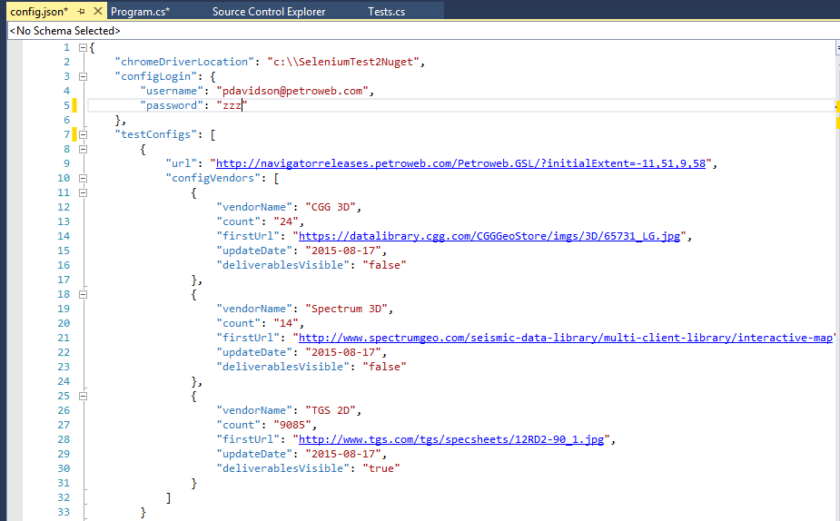
Our Configuration
Notes:
Output could be regular test classes instead of a Console app, but our QA person seems to be allergic to Visual Studio

Slide 10
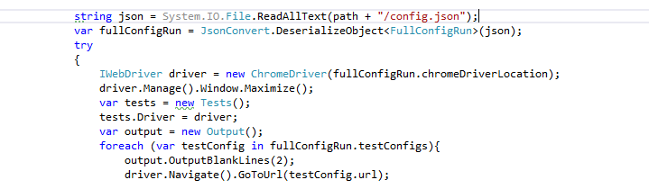
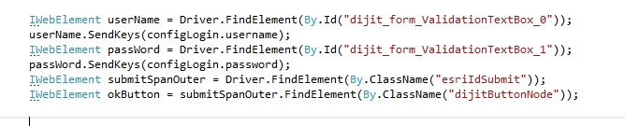
Code
Notes:
Primary Code
First 2 lines are about me loading my config
Driver initialization loads, I then maximize the window as I want it to run the same size every time.
I initialize a few of my own classes and then start looping through my configuration and Navigating to the URL.
Here is one sample of what I do with that url. This is the UserName and Password. I find the two elements, and put the text I want into each of them, then find the Submit button.. (You want to make sure you have IDs on EVERYTHING if you want to do this...(Which can be a little harder if you are stamping out a template using a binding framework.)
Then click the ‘Submit’ Button

Slide 11
Run Sample
Notes:
C:\Users\Casey\Desktop\SeleniumTest2Nuget\bin\Debug

Slide 12
Selenium Web Driver Analysis
I’m a fan.
http://www.seleniumhq.org/
https://www.pluralsight.com/courses/automated-testing-framework-selenium
Notes:
Easy to run
Easy to build

Slide 13
Thanks
Questions:
gcaseycupp@gmail.com
https://github.com/gcaseycupp

